Slide 1
9:41
NEXT

Slide 2
9:41
BACK
NEXT

Slide 3
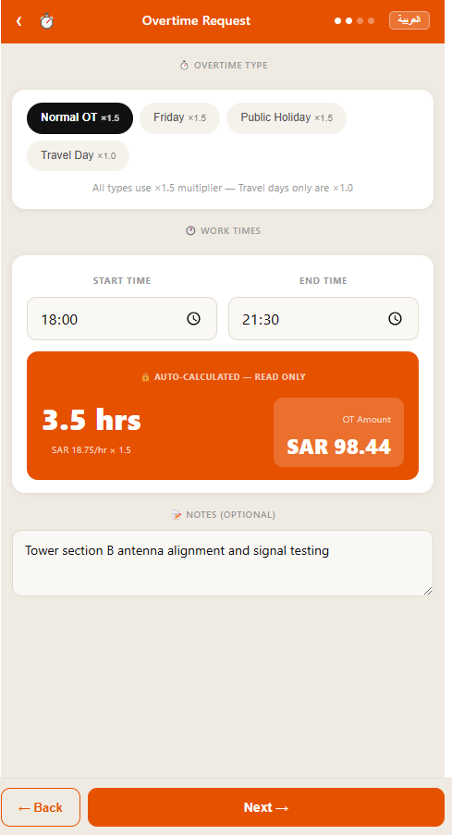
9:41
BACK
NEXT

Slide 4
9:41
BACK
SUBMIT

Slide 5
9:41

